Slide 1
Unit 4 | Electromagnetism
A | Gauss’s theorem and its applications, Electric potential, and potential difference, Biot-Savart law and its application to current carrying circular loop | CO4
B | Ampere’s law and its applications to infinitely long straight wire, and solenoids. Electromagnetic induction; Faraday’s law | CO4
C | Maxwell’s equations in free space and dielectric media, Electromagnetic waves. | CO4

Slide 2
Coulomb’s law
SI standard quantity of a charge is a Coulomb (C)
  1 C = 6.0 x 10 ¹⁸ electrons
  1.6 x 10 ⁻¹⁹ C = 1 electron (-) or
  1 Proton (+) or 1 “elementary” charge
Electric Force : (one of the 4 major forces) varies inversely with the distance between the charge
  F α 1
  d²

Slide 3
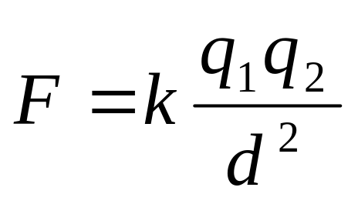
Coulomb’s law:
  Electrical force is proportional to the product of the electrical charge and inversely proportional to the square of the distance. This is known as Coulomb’s law.
  Mathematically,
    where,
    F is the force,
    k is a constant and has the value of 9.00 x 10⁹ Newton•meters²/coulomb² (9.00 x 10 ⁹ N•m²/C²),
    q₁ represents the electrical charge of object 1 and q₂ represents the electrical charge of object 2, and
    d is the distance between the two objects.

Slide 4



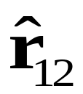

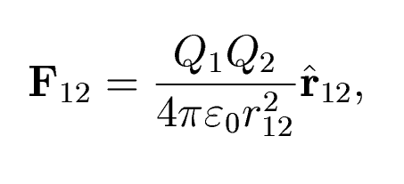
Vector form of Coulomb’s Law
+
Q2
-
r₁₂
+
Q1
+

Slide 5
The Electric Field
Coulomb's Law (demonstrated in 1785) shows that charged particles exert forces on each other over great distances.
How does a charged particle "know" another one is “there?”

Slide 6
Faraday, beginning in the 1830's, was the leader in developing the idea of the electric field. Here's the idea:
F₁₂
• A charged particle emanates a "field" into all space.
+
F₁₃
• Another charged particle senses the field, and “knows” that the first one is there.
F₃₁
+
-
F₂₁
unlike charges attract
like charges repel

Slide 7
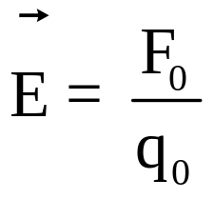
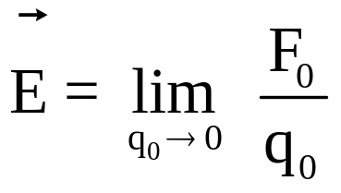

We define the electric field by the force it exerts on a test charge q₀:
By convention the direction of the electric field is the direction of the force exerted on a POSITIVE test charge. The absence of absolute value signs around q₀ means you must include the sign of q₀ in your work.
If the test charge is "too big" it perturbs the electric field, so the “correct” definition is
You won’t be required to use this version of the equation.
Any time you know the electric field, you can use this equation to calculate the force on a charged particle in that electric field.
Dr. Munendra

Slide 8
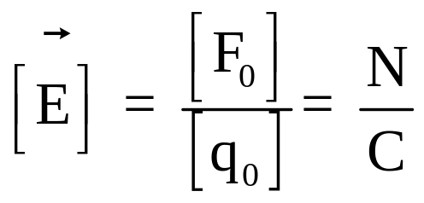
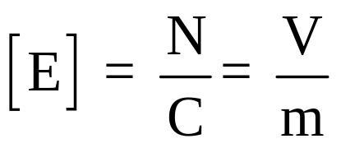
The units of electric field are Newtons/Coulomb.
Later you will learn that the units of electric field can also be expressed as volts/meter:
The electric field exists independent of whether there is a charged particle around to “feel” it.

Slide 9
Remember: the electric field direction is the direction a + charge would feel a force.
+
A + charge would be repelled by another + charge.
Therefore the direction of the electric field is away from positive (and towards negative).

Slide 10
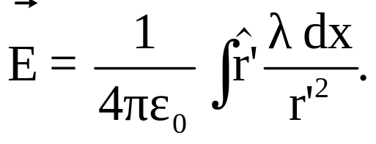
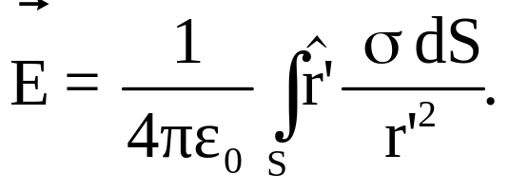
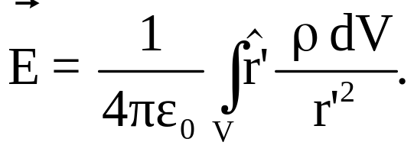
Summarizing:
Charge distributed along a line:
Charge distributed over a surface:
Charge distributed inside a volume:
If the charge distribution is uniform, then λ, σ, and ρ can be taken outside the integrals.

Slide 11
The Electric Field
Due to a Continuous Charge Distribution
Can be found using Coulomb’s Law. However, It is much easier using Gauss’s law.

Slide 12
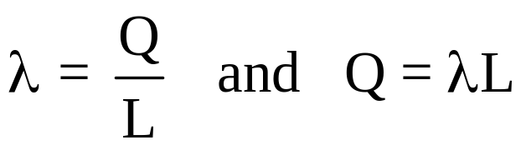
Example: A rod of length L has a uniform charge per unit length λ and a total charge Q. Calculate the electric field at a point P along the axis of the rod at a distance d from one end using Coulomb’s law.
y
P
x
d
L
Let’s put the origin at P. The linear charge density and Q are related by
Let’s assume Q is positive.

Slide 13
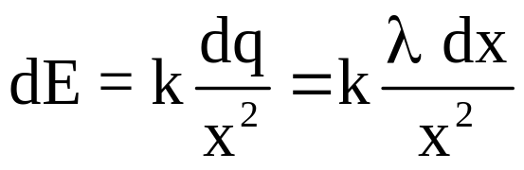
y
x
dx
dQ = λ dx
dE
P
x
d
L
The electric field points away from the rod. By symmetry, the electric field on the axis of the rod has no y-component. dE from the charge on an infinitesimal length dx of rod is

Slide 14
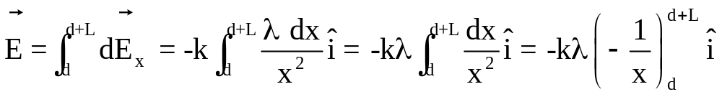
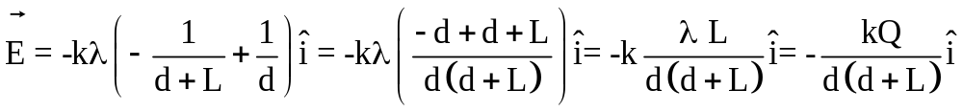
y
x
dx
dQ = λ dx
dE
P
x
d
L

Slide 15
Gauss’ Law
Electric Flux
We have used electric field lines to visualize electric fields and indicate their strength.
We are now going to count the number of electric field lines passing through a surface, and use this count to determine the electric field.
E

Slide 16
The electric flux passing through a surface is the number of electric field lines that pass through it.
Because electric field lines are drawn arbitrarily, we quantify electric flux like this: Φ_{E}=EA, except that…
A
E
If the surface is tilted, fewer lines cut the surface.
Later we’ll learn about magnetic flux, which is why I will use the subscript E on electric flux.
E
θ

Slide 17
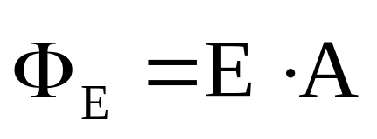
We define A to be a vector having a magnitude equal to the area of the surface, in a direction normal to the surface.
A
θ
E
θ
The “amount of surface” perpendicular to the electric field is A cos θ.
Because A is perpendicular to the surface, the amount of A parallel to the electric field is A cos θ.
A|| = A cos θ so Φ_{E} = EA|| = EA cos θ.

Slide 18
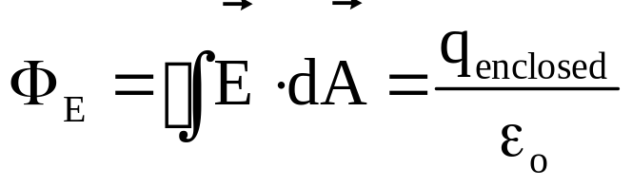
Gauss’ Law
Mathematically, we express it as
Gauss’ Law
What is it’s differential form?
We will find that Gauss law gives a simple way to calculate electric fields for charge distributions that exhibit a high degree of symmetry…

Slide 19
Strategy for Solving Gauss’ Law Problems
• Select a Gaussian surface with symmetry that matches the charge distribution.
• Draw the Gaussian surface so that the electric field is either constant or zero at all points on the Gaussian surface.
• Use symmetry to determine the direction of E on the Gaussian surface.
• Evaluate the surface integral (electric flux).
• Determine the charge inside the Gaussian surface.
• Solve for E.

Slide 20
Next few slides will explain the use of Gauss’ law with the help of following 10 worked examples:
Flux through a cylinder
E due to charges spread over a long line
E due to a point charge
E due to a sphere
E due to sheet
E due to two sheets
E due to hollow shell
E due to hollow cylinder

Slide 21
Worked Example 1
Compute the electric flux from a cylinder with an axis parallel to the electric
field direction.
E
A
The flux through the curved surface is zero since E is perpendicular to dA there. For the ends, the surfaces are perpendicular to E, and E and A are parallel. Thus the flux through the left end (into the cylinder) is –EA, while the flux through right end (out of the cylinder) is +EA. Hence the net flux from the cylinder is zero.

Slide 22
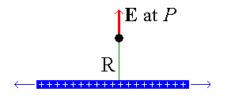
Worked Example 2
Field due to a long line charge
1) Understand the geometry
Pick a point P for evaluation of E.
2) Understand the symmetry
The only variable on which E may depend is R, the distance from the line of charge. There is no angular dependence because the line is cylindrically symmetric, i.e. it does not matter at which angle about the line you view it. There is no axial dependence because the line of charge is infinitely long, i.e. there is no preferred position along the line.
Similar arguments determine that the direction of E is directly away from the line, perpendicular to it at all locations. There may be no azimuthally or axial components because the line is infinite and has no extent in the transverse directions.

Slide 23
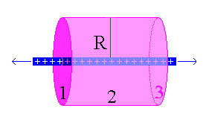
Worked Example 2 contd….
3) Construct the Gaussian surface
A cylindrical tube is chosen to match the symmetry of the line of charge, centered about it, with a radius equal to the distance between the point of evaluation and the line of charge. The electric field anywhere on this surface has the same direction as the infinitesimal area vector and has a constant value everywhere on the surface. This surface is denoted by 2.
Since a gaussian surface must be closed, the tube is then capped with flat endcaps, 1 and 3. The electric field does not have the same value at all points on the endcaps, but the field vector is perpendicular to the area vector so there is no flux through the endcaps.

Slide 24
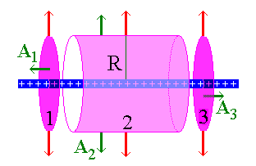
Worked Example 2 contd….
4) Examine the Gaussian surface
The flux through the endcap 1 is zero since A₁ is perpendicular to E everywhere on this surface. Similarly, the flux through surface 3 is zero.
Since the electric field is everywhere constant on surface 2 and points in the same direction as the surface vector at any point, the flux through surface 2 will be the field magnitude E times the area of the tube wall.

Slide 25
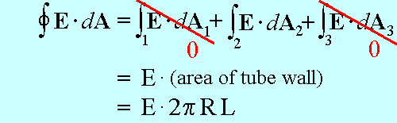

Cylindrical Symmetry
5) Evaluate the electric flux through the Gaussian surface
6) Evaluate the charge enclosed by the Gaussian surface
Dr. Munendra

Slide 26
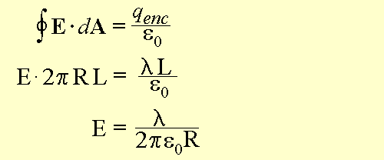
Worked Example 2 contd….
7) Apply Gauss's law for the result!
Source: http://www.physics.udel.edu/~watson/phys208/line-gauss/line-gauss1.html

Slide 27
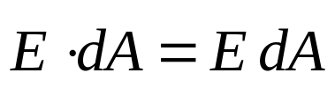
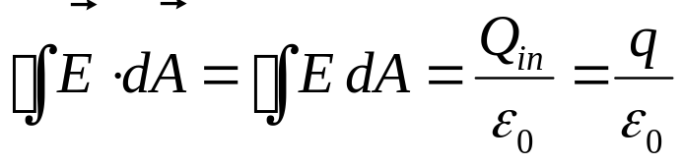
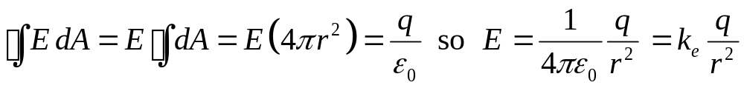
Worked Example 3
Starting with Gauss’s law, calculate the electric field due to an isolated point charge q.
We choose a Gaussian surface that is a sphere of radius r centered on the point charge. I have chosen the charge to be positive so the field is radial outward by symmetry and therefore everywhere perpendicular to the Gaussian surface.
E
r
q
dA
Gauss’s law then gives:
Symmetry tells us that the field is
constant on the Gaussian surface.

Slide 28
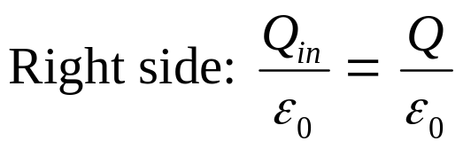
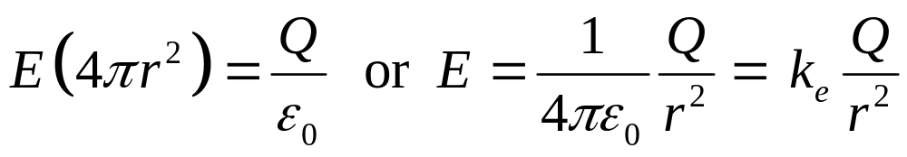
Worked Example 4
An insulating sphere of radius a has a uniform charge density ρ and a total
positive charge Q. Calculate the electric field outside the sphere.
Since the charge distribution is spherically symmetric we select a spherical Gaussian surface of radius r > a centered on the charged sphere. Since the charged sphere has a positive charge, the field will be directed radially outward. On the Gaussian sphere E is always parallel to dA, and is constant.
E
r
a
dA
Q
◆
❖
⬥

Slide 29
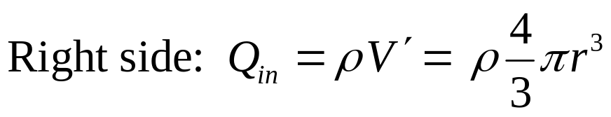
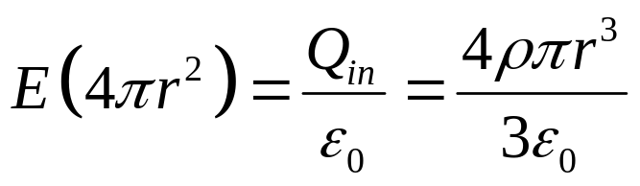
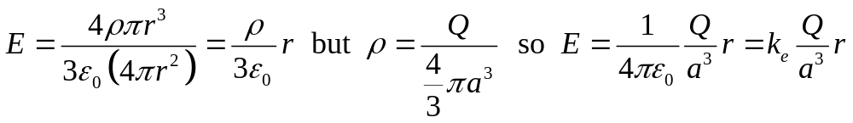
Worked Example 4 cont’d
Find the electric field at a point inside the sphere.
Now we select a spherical Gaussian surface with radius r < a. Again the symmetry of the charge distribution allows us to simply evaluate the left side of Gauss’s law just as before.
r
a
◆
Q
The charge inside the Gaussian sphere is no longer Q. If we call the Gaussian sphere volume V’’ then
❖
⬥


Slide 30
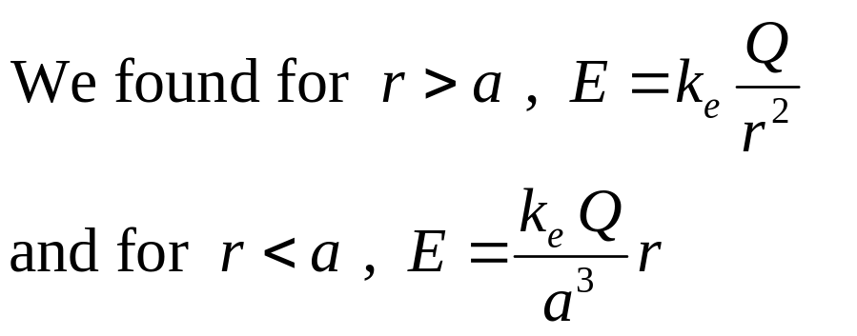
Worked Example 4 cont’d
a
Q
E
Let’s plot this:
a
r

Slide 31
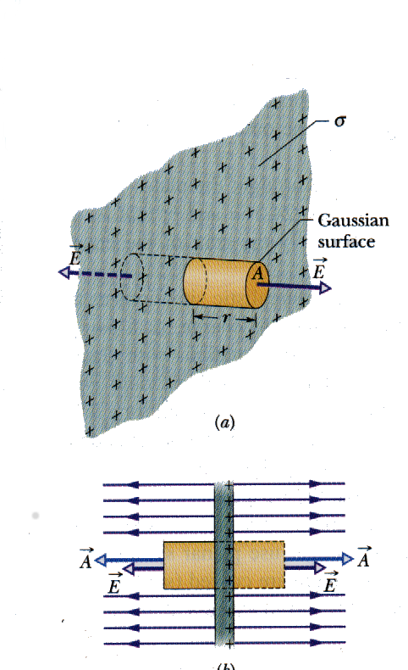


Worked Example 5
E due to a sheet
Two different views of a very large thin plastic sheet, uniformly charged on one side with surface density of σ. A closed cylindrical Gaussian surface passes throught the sheet and is perpendicular.
From symmetry , E must be perpedicular to the surface and endcaps. The surface charge is positive so E emanates from the surface. Since the field lines do not piece the curved surface there is no flux.
What happens if we magically make the sheet a conductor ?? Will the E field change ?

Slide 32
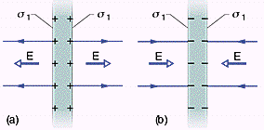
Worked Example 5 cont’d
Figure (a) show a cross-section of a thin, infinite conducting plate with excess positive charge. We know the this excess charge lies on the surface of the plate. If there is no external electric field to force the charge into some particular distribution, it will spread out onto the two surfaces with an uniform charge density of σ₁. From the previous slide we know this charge sets up an electric field E=σ₁/ε₀ which points
away from the plate. Figure (b) is a identical plate with negative charge. In this case E points inward.
1

Slide 33
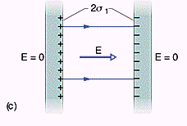

Worked Example 6
E due to two sheets
Suppose we move the two plates in the figures (a) and (b) close together and parallel. Since the plates are conductors, the excess charge on one plate attracts the excess charge on the other and all the excess charge moves into the inner faces of the plates. The new surface charge density has now doubled,
therefore the electric field between the plates is
The field points away from positive charged plate and toward the negative plate. Since no excess is left on the outer faces, the electric field outside is zero.

Slide 34
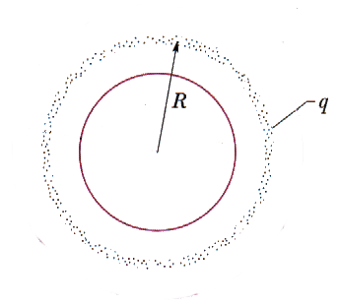
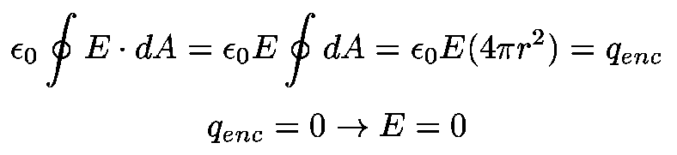
Worked Example 7
E due to hollow spherical shell
1st choose an Gaussian surface inside the shell that coincides with the point x.
Since fields lines can not cross, the spherical symmetry requires E field to be in the radially direction and uniform on the Gaussian surface, therefore Gauss’ Law
x
r

Slide 35
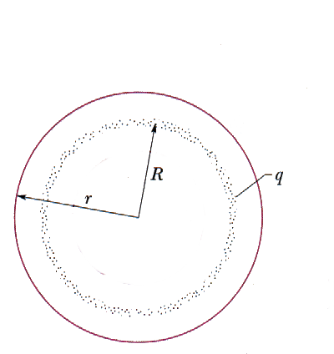
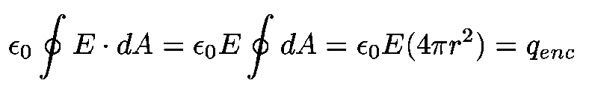
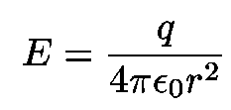
Worked Example 7 cont’d
Now let’s consider the electric field at a point outside the charged sphere.
We define a Gaussian surface around the sphere for which r>R.
Again since fields lines can not cross, the spherical symmetry requires E field to be in the radially direction and uniform on the Gaussian surface, therefore Gauss’ Law becomes
Outside the hollow sphere
x
Same as point charge

Slide 36
Worked Example 7 cont’d
Using Gauss’ Law we were able to prove two shell theorems .
A shell of uniform charge attracts and repels a charged particle that is outside the shell as if all shell’s charge were concentrated at the center.
If a charged particle is located inside a shell of uniform charge, there is no net electric force on the particle from the shell.

Slide 37
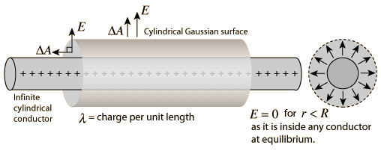
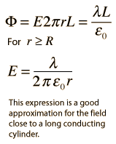
Worked Example 8
E due to long cylinder
Considering a Gaussian surface in the form of a cylinder at radius r > R, the electric field has the same magnitude at every point of the cylinder and is directed outward. The electric flux is then just the electric field times the area of the cylinder.

